Slide 1
Comment Anywhere

Slide 2
Project Overview

Slide 3
What Is Comment Anywhere?
Comment Anywhere is a web service that allows users to access a unique comment section for any webpage on the internet.
Comment Sections are viewed and posted to via the Comment Anywhere Front End, which is a browser extension for Mozilla Firefox that any internet user can download and install in their browser.
Comments are served from the Comment Anywhere Back End, a cloud-hosted database and HTTP server that manages authentication, data storage, and data retrieval.

Slide 4
Motivation
Comment Sections on websites were once ubiquitous; now, many have closed. [1]
Conversations have moved to social media posts. (Facebook, Twitter, Reddit)
Social media posts as comment sources fundamentally fragment the conversation.
Conversation (and valuable comment information) becomes split between many posts.
While it is usually easy to go from a comment section on social media to the content, it is very hard to go from the content to the many posts on social media.
There should exist comment sections that are closely coupled to the content.
These comment sections should follow the content wherever it is shared, on any platform.
This makes it more difficult for agendas to silence disempowered voices.
This makes information easily accessible and available to all.

Slide 5
System Overview: Back End

Slide 6
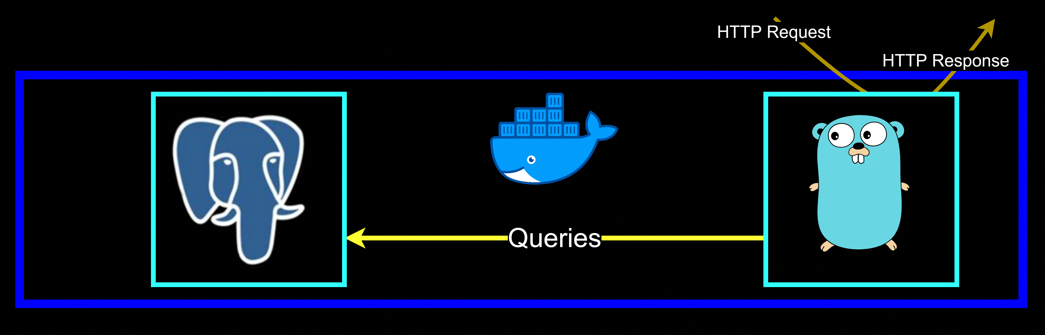
Two Core System Processes
The two core system processes required for the back end to function are:
The Postgres Database
The Go HTTP Server
Both run in Docker containers.

Slide 7
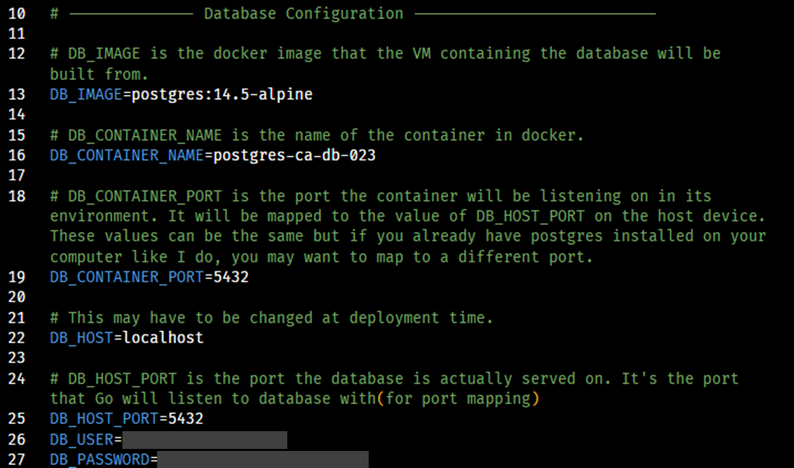
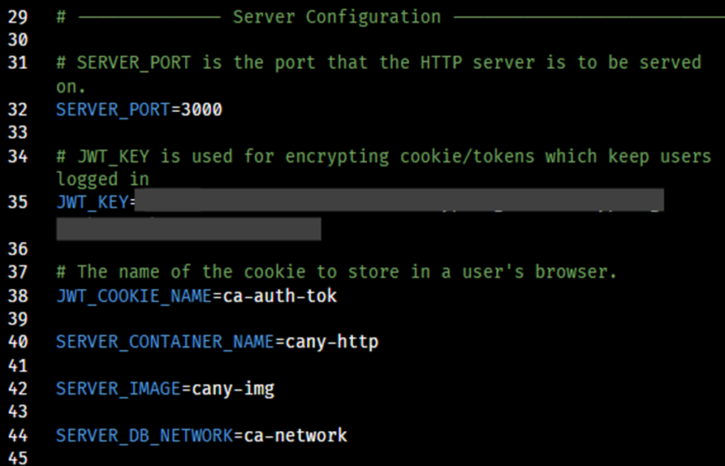
Environment Variables
The two back-end processes easily communicate with few user errors because they both reference the same single set of variables at the time they are initialized, located in a private .env file.

Slide 8
Database System Overview
16 Tables
25 Foreign Key Relations
84 Total Columns
Uses postgres:14.5-alpine docker image as the base.
Used dbdiagram.io to design the initial database; there were ultimately a number of changes.
Uses golang-migrate to systematize applying our schema and changes.
Uses kyleconroy/sqlc to generate Go structs from the schema and queries.

Slide 9
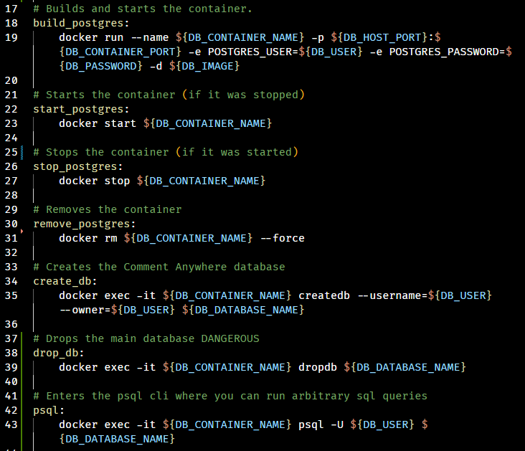
Database: Building
Pictured to the right are snippets from our Makefile.
By importing our .env file to our Makefile, we are able to utilize our environment variables when running command-line executables.
Running make commands this way minimizes user mistakes and repetition.

Slide 10
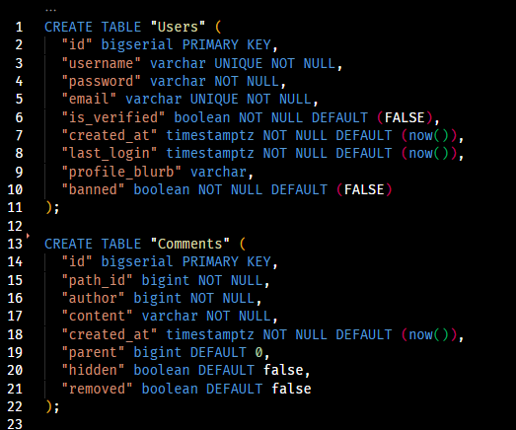
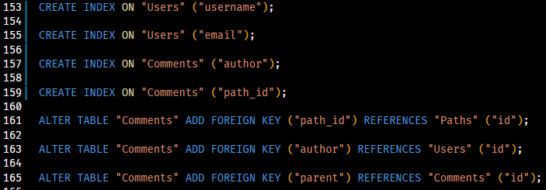
Database: Schema Snippet
Pictured to the right are snippets from our schema SQL file.
The SQL is formatted using Postgres types and conventions.
Indexes are added for frequently used query dimensions.
Foreign keys are added to allow joins and ensure data validity.

Slide 11
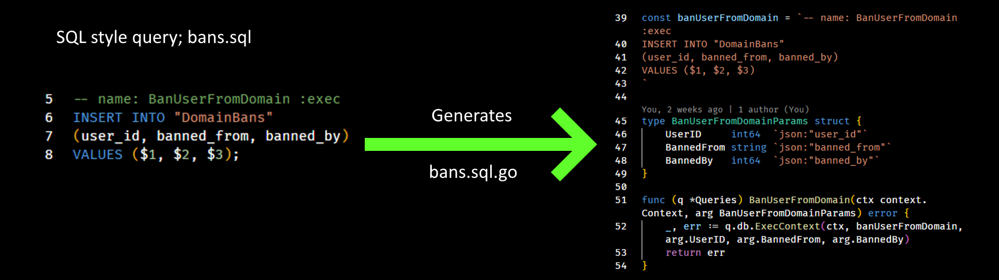
Database: Generating Type-Safe Go Code
Part of the Go Code used on our HTTP Server is automatically generated from the schema of the database and a set of queries.
A program called kyleconroy/sqlc performs the work of transforming that SQL into idiomatic Go, creating types and functions as needed.
67 characters to 498 characters; 750% code multiplier

Slide 12
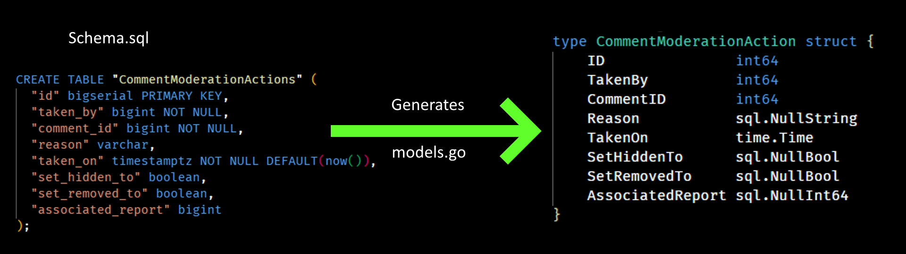
Database: Generating Type-Safe Go Code
A type is also generated for every row-type in the database.
When our schema changes, we can simply re-run sqlc, allowing most changes to be instantly realized in our Go code, minimizing redundancy and the risk of human mistakes.

Slide 13
HTTP Server Code Overview
Coded in Go, primarily for its lightweight threads in order to reduce cloud overhead.
5 modules; server, util, config, communication, and database
server consists of 37 .go files comprising 2,344 lines of non-comment code.
util consists 3 .go files comprising 137 lines of non-comment code.
config contains 1 .go files comprising 382 lines of non-comment code.
communication contains 3 .go files comprising 245 lines of non-comment code.
database contains 14 non-generated and 19 generated source code files comprising 2,600 lines of non-comment code.
There are also 98 lines of Makefile and 11 lines of YAML.
In total, the HTTP Server requires 5,806 lines of code.

Slide 14
HTTP Server Structure Overview
The module server provides the top-level Server object, which provides methods for handling HTTP Request at each endpoint.
The module communication provides types for parsing the JSON data sent from the Front-End and types for building JSON data to respond with.
The module database provides the Store object, whose methods wrap the functions generated by sqlc. Generally, Store executes database queries and converts the results to communication types.
The module config validates and loads the .env file.
The module util provides pure functions for utility purposes, that perform, for example, regular expression input validation and password encryption.

Slide 15
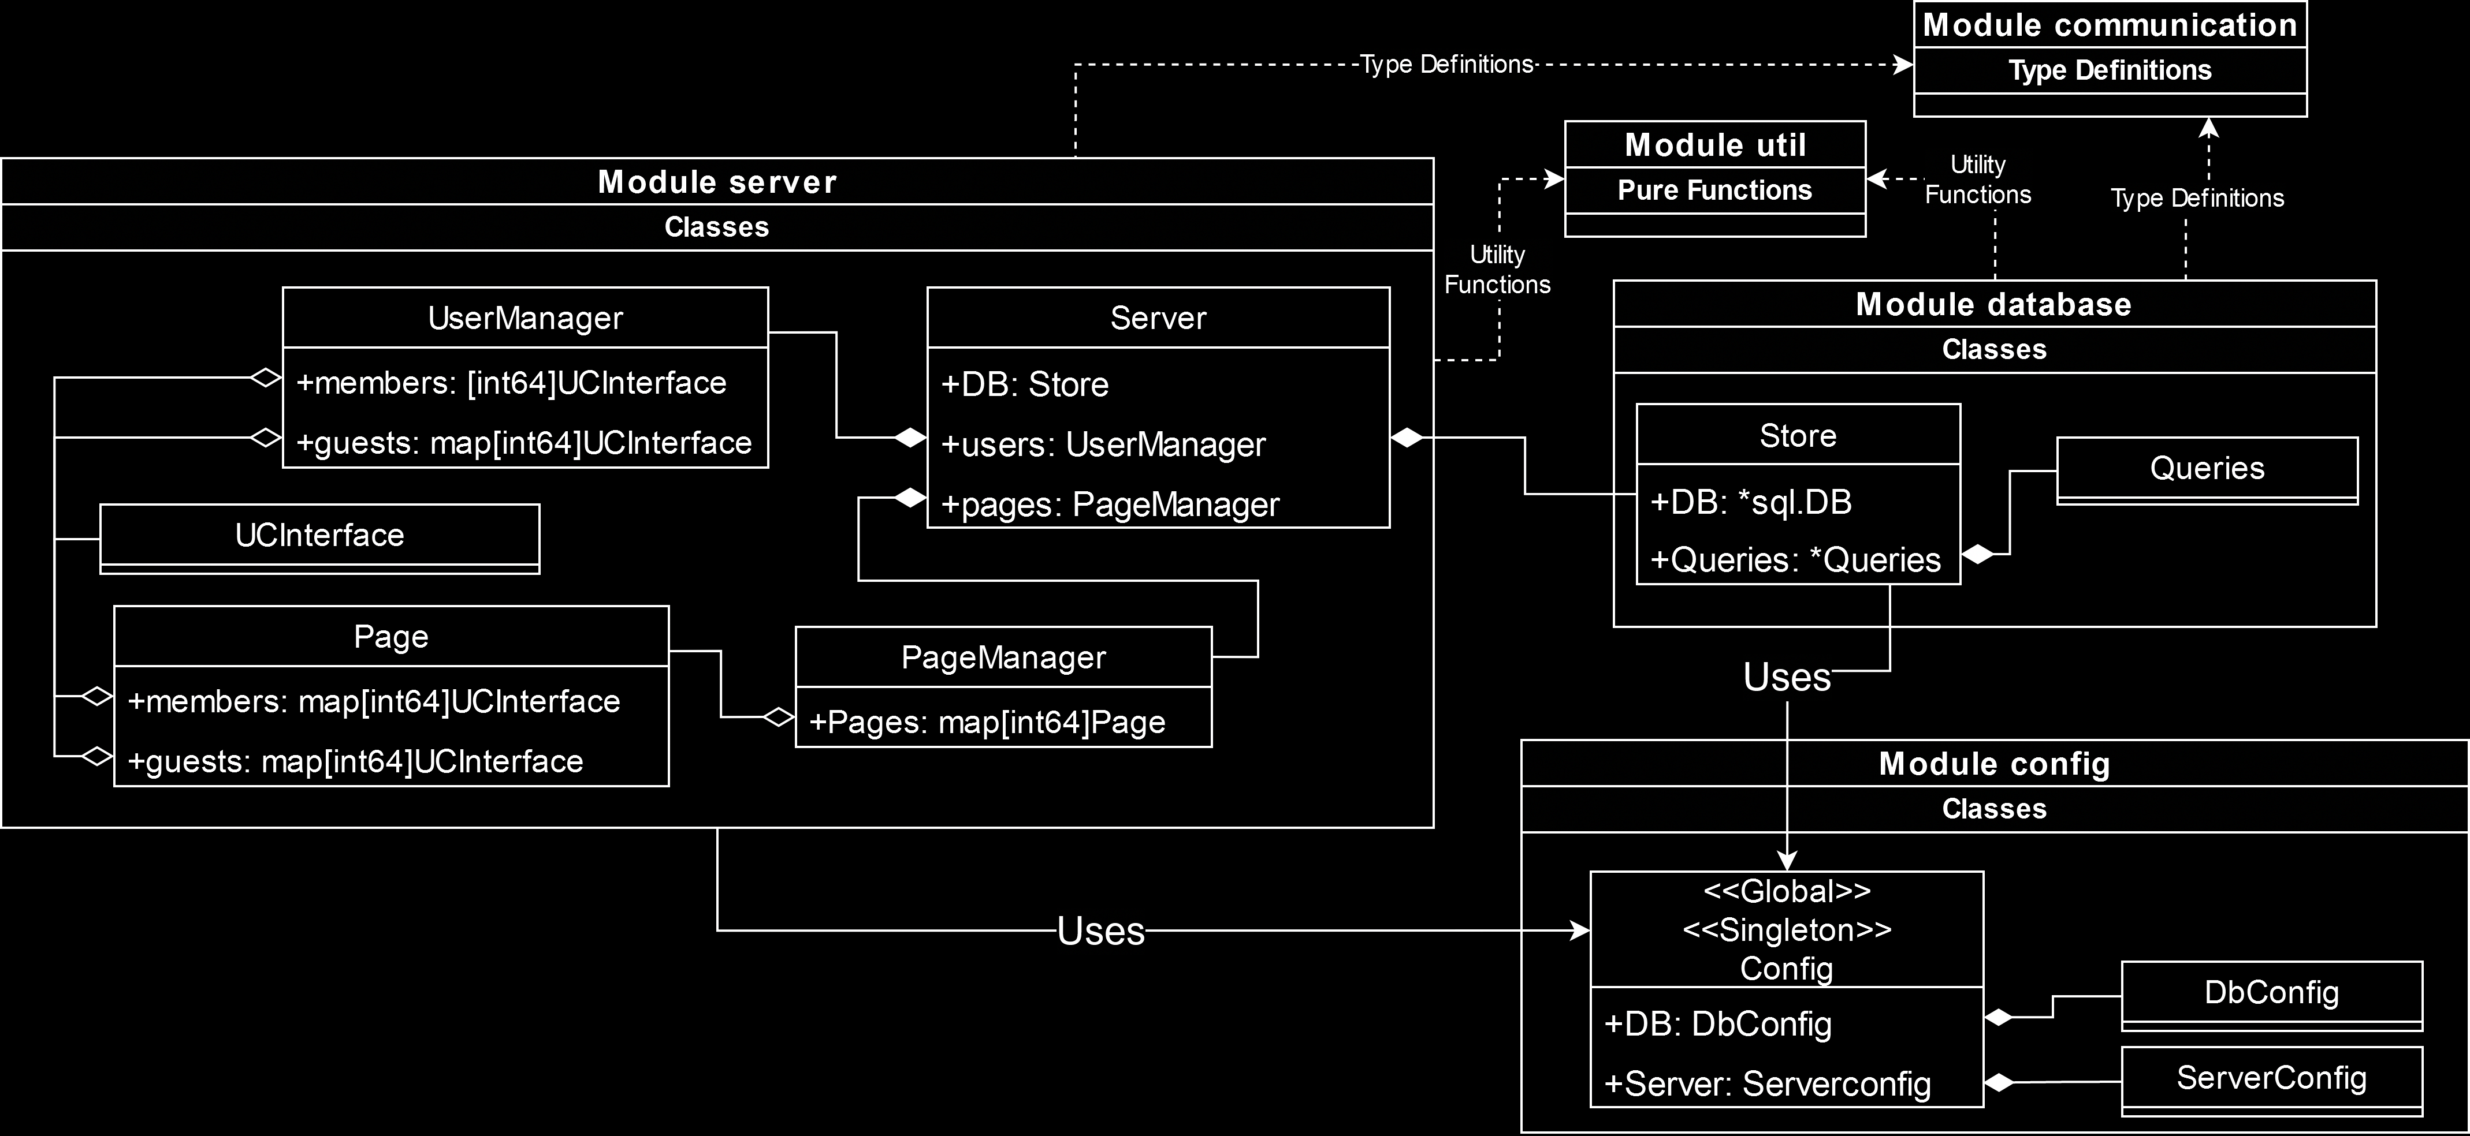
HTTP Server Structure Diagram

Slide 16
HTTP Server Structure Overview
I will describe these modules starting with the simplest and moving to the more complex.
They will be addressed in this order:
config
communication
util
database
server

Slide 17
HTTP Server Structure Diagram

Slide 18
HTTP Server : Module config
The module config is a simple module. It simply looks for the .env file and uses it to load environment variables, then confirms that all the necessary environment variables are loaded. If some required ones are missing, it prints the appropriate error message and fatally crashes the HTTP Server.
The Config object is available to all other modules as a global singleton.
Config.Load is called in main immediately after command line arguments have been parsed to validate the environment variables.
The server cannot run if required, non-defaulting environment variables are not available.

Slide 19
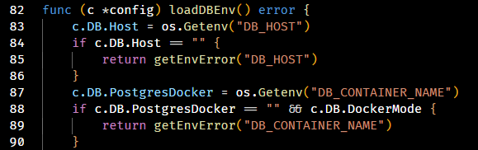
HTTP Server : Module config
The code below is an interesting case. It demonstrates how config requires the environment “DB_CONTAINER_NAME” be present but only if “DockerMode” is true.
DockerMode is set when the executable is run with the flag –docker=true.
This is necessary because Config can produce a database connection string from its environment variables, and this string looks different if the HTTP Server process is running inside a docker container and connecting to the database over a docker network.

Slide 20
HTTP Server Structure Diagram

Slide 21
HTTP Server : Module communication
The module communication provides the types expected by both the HTTP server and front-end client.
For example, the “/register” endpoint expects the body of the HTTP Request to contain a JSON string that can be parsed into a client-to-server communication entity structured as follows:
// Register is dispatched to the server when the client clicks “Submit” on the register form.
type Register struct {
Username string
Password string
RetypePassword string
Email string
AgreedToTerms bool
}

Slide 22
HTTP Server : Module communication
The body of the HTTP Response to a client will ultimately contain a JSON-style string that can be parsed into an array of server-to-client communication entities, which the Front End will process.
For example, the Message entity, often sent when there is a problem with a request, will cause a message to display on the Front End, in either blue or red.
// Message is a general communication entity used to provide feedback to a client that some action has completed (or not completed)
type Message struct {
Success bool
Text string
}

Slide 23
HTTP Server : Module communication
Some messages to the client may be considerably more complex than that. The FullPage and composite server-client communication entities are shown.
// Comment provides the data the Front End needs to render a comment.
type Comment struct {
UserId int64
Username string
CommentId int64
Content string
Factual CommentVoteDimension
Funny CommentVoteDimension
Agree CommentVoteDimension
Hidden bool
Parent int64
Removed bool
TimePosted int64
}
// FullPage is returned when a user first requests comments for a new page. It contains an array of all comment data for that page.
type FullPage struct {
Comments []Comment
Domain string
Path string
}
// CommentVoteDimension contains data for the number of votes on a comment.
type CommentVoteDimension struct {
AlreadyVoted int8
Downs int64
Ups int64
}

Slide 24
HTTP Server Structure Diagram

Slide 25
HTTP Server : Module database
The primary purpose of module database is to wrap calls to the functions generated by sqlc (the code-generation software), abstracting and simplifying the database operations.
These abstractions are implemented as methods of the object database.Store, which is referenced as a top-level member of server.Server.
Store contains a reference to generated.Queries as Store.Queries.
Store methods may make one or more calls to Store.Queries and return either some primitive or transform the data returned by Queries into some communication type(s) and return that.

Slide 26
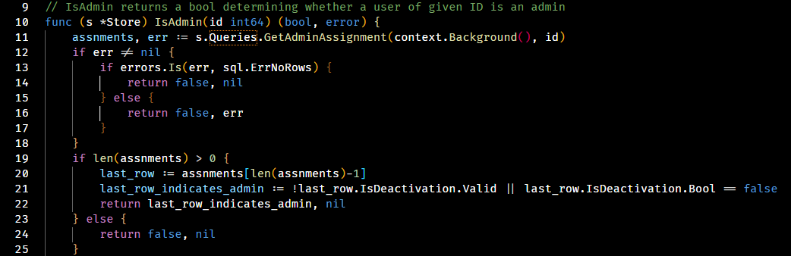
HTTP Server : Module database
For example, when initializing a UserController (described later), we will need to know whether they are an admin. This information is stored in the AdminAssignments table, not in the Users table. Store provides a Boolean-returning method for determining Admin status of a user.

Slide 27
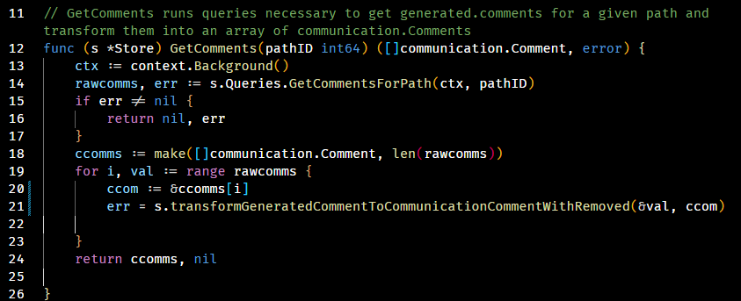
HTTP Server : Module database
Often, Store produces communication entities. In the example, the call to the wordy “transform” function takes raw comment data and builds the final communication entities from it. For example, it hides the content of removed comments and runs an aggregate query to get the vote total.

Slide 28
HTTP Server Structure Diagram

Slide 29
HTTP Server : UserControllerInterface
The entity associated with users as they navigate around server data is UserControllerInterface.
This interface can be a GuestController, MemberController, DomainModeratorController, GlobalModeratorController, or AdminController ; all implement the methods and are used polymorphically.
The UserManager maintains a map of all guest controllers who have recently accessed Comment Anywhere in one map, and all member-or-higher controllers in another.
Each Page, representing a distinct comment section initialized from database data, also keeps a map of controllers that are currently viewing it, so that it can de-initialize when its data is no longer needed.

Slide 30
HTTP Server : UserControllerInterface
TODO: UML DIAGRAM OF INHERITANCE WITH UCI

Slide 31
HTTP Server : UserControllerInterface
A reference to a user’s associated controller is attached to their HTTP Request Context at the time their authentication token is parsed by the middleware. A controller is always attached to a request; if a login token is not existent or invalid, a new GuestController is created for the Request.
The actual calls which realize the effects of a user action, such as posting a comment, are made in their particular controller. The Server object itself is, in general, unconcerned with the access level of a given controller and simply parses the HTTP Request’s body into the appropriate communication type, then hands off the execution of the command to the controller already associated with the request.
Server.PostNewComment may call, for example, HandleNewComment on the interface; if they are a logged in user, a new comment will be posted. If they are a Guest, they will simply receive an error message to display.

Slide 32
HTTP Server : UserControllerInterface
UserControllers have a member array of communication types called nextResponse.
As a request is processed, communication entities, ranging from LoginResponses to Messages to Comment data are pushed to this array.
A request may cause communication entities to be pushed to other UserControllers as well. For example, posting a new comment will cause that new comment data to be pushed to the nextResponse array of all controllers who are currently on that page.
When a request finishes, nextResponse is sent as a JSON array in the body of the HTTP Response.
The front end parses each item of this response and renders changes on the UI accordingly.
Typically, the response items will only be related to the action the user just attempted to perform, but if it has been a while since they talked to the server, there may also be additional items waiting for them.

Slide 33
HTTP Server : Anatomy of a Request’s Life - Preflight
Our server is atypical in that the user is not talking to the server from a webpage we have provided them. They are on some other website or “none” at all in the browser environment.
For this reason, we need to enable a special policy called Cross Origin Resource Sharing (CORS), or modern browsers will interrupt the request.
MDN defines CORS as follows [1]:
“Cross-Origin Resource Sharing (CORS) is an HTTP-header based mechanism that allows a server to indicate any origins (domain, scheme, or port) other than its own from which a browser should permit loading resources. CORS also relies on a mechanism by which browsers make a "preflight" request to the server hosting the cross-origin resource, in order to check that the server will permit the actual request. In that preflight, the browser sends headers that indicate the HTTP method and headers that will be used in the actual request.”

Slide 34
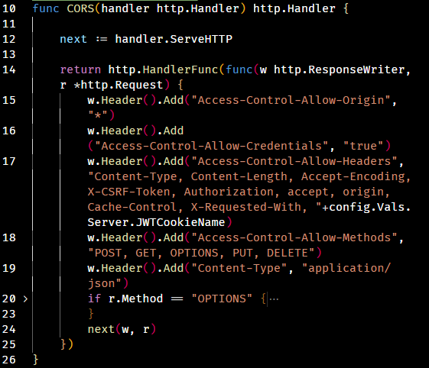
HTTP Server : Anatomy of a Request’s Life - Preflight

Slide 35
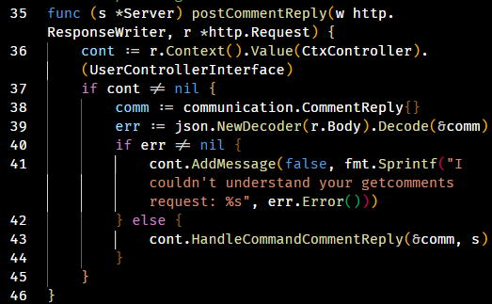
HTTP Server : Anatomy of a Request’s Life - Endpoint

